Slide 1
MACHINE LEARNING
House Price Prediction
Burak Doğanay

Slide 2
What we did in this project – Summary
In this project, we tried to predict the prices of other houses according to the values ​​of these features with the model we obtained by training a data set containing some features and prices of real houses with linear regression and decision tree regression methods.
1 – Data set
2 – Feature Engineering
3 – Model Training
4 - Coding

Slide 3
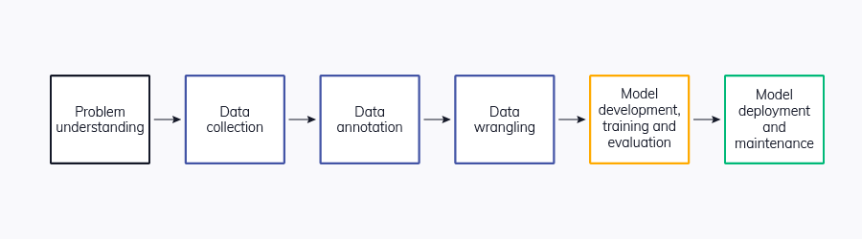
Road Map

Slide 4
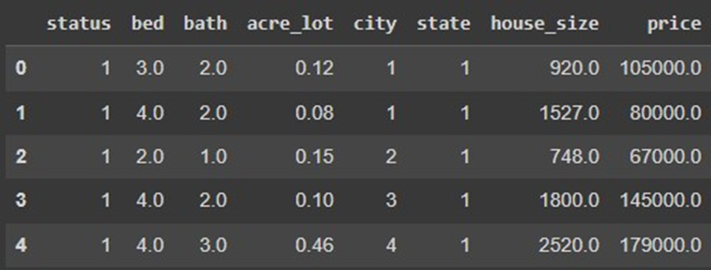
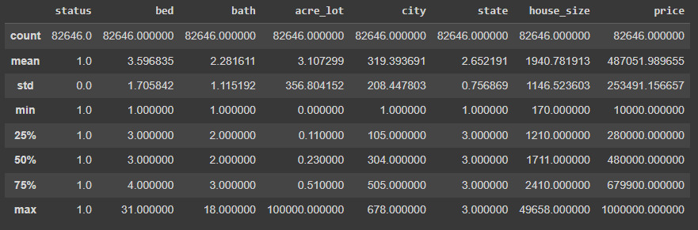
Data Set

Slide 5
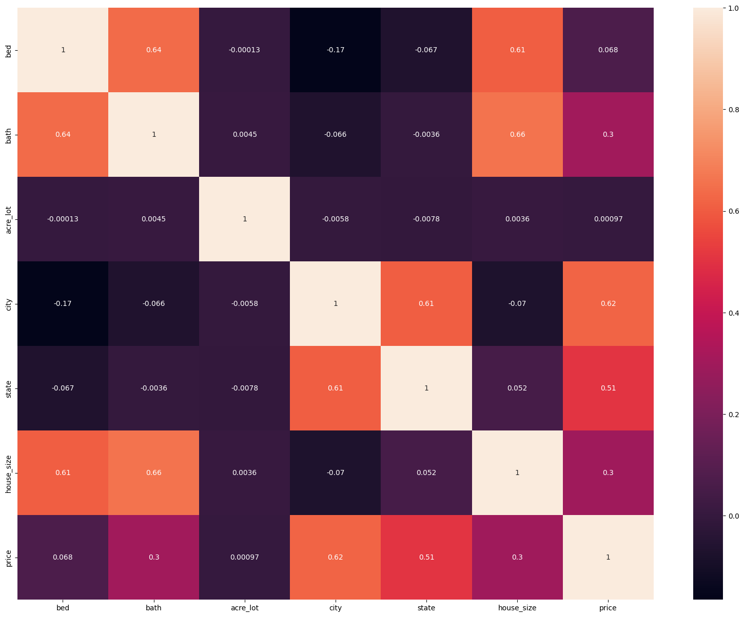
Heatmap

Slide 6
Feature Engineering
Feature engineering is the process of transforming raw data into a format that boosts the performance of machine learning models. Imagine you're building a model to predict the price of houses. Raw data like street address, number of bedrooms, and square footage might not be enough. Feature engineering helps you extract and create new features that are more relevant and informative for your model.
Methods we Used:
Data Transformation
Data Standardization

Slide 7
Modals That We Used
Model training is the heart of the machine learning process, where an algorithm learns from data to make predictions. It's like teaching a student by showing them examples and letting them practice until they can do it themselves.
Linear Regression
Decision Tree Regression

Slide 8
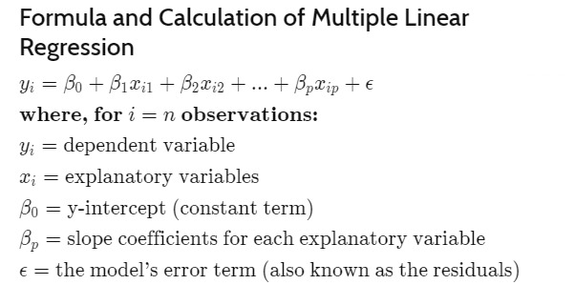
Linear Regression
Multiple linear regression is a statistical method used to analyze the relationship between one or more independent variables and a single dependent variable. Unlike single linear regression, which considers only one independent variable, multiple linear regression takes more than one predictor variable into account.

Slide 9
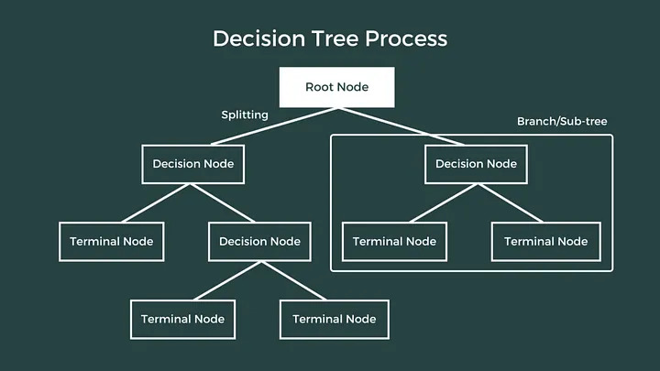
Decision Tree Regression
Decision Tree Regression is a machine learning algorithm used for predicting a continuous target variable based on one or more input features. Unlike classification trees that predict categorical outcomes, decision tree regression models are designed for numeric or continuous predictions.

Slide 10
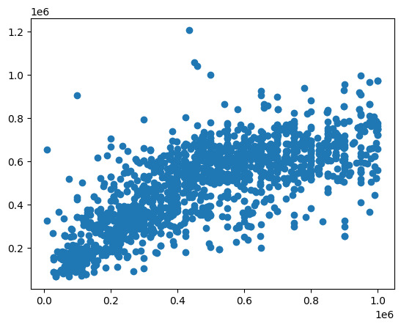
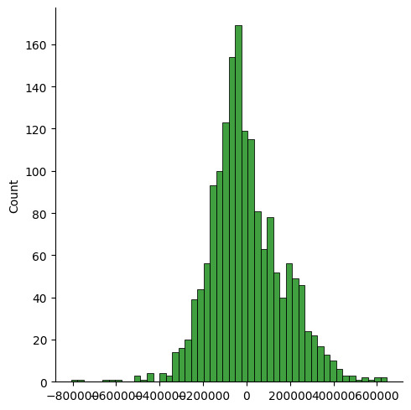
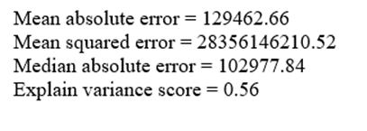
Results of Linear Regression
Scatter Plots
Distplot

Slide 11
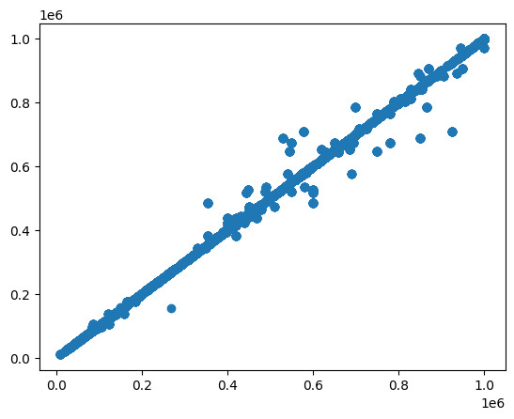
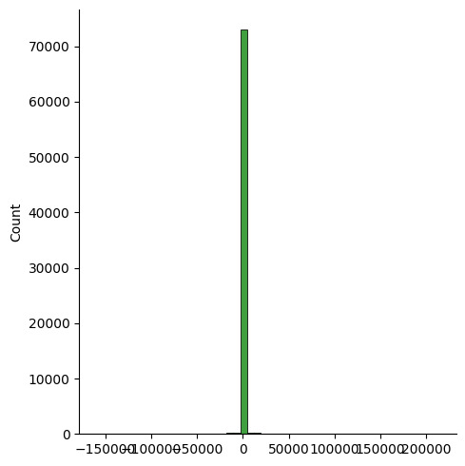
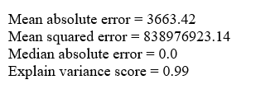
Results of Decision Tree Regression
Scatter Plots
Distplot

Slide 12
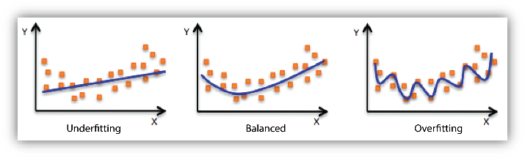
Underfitting-Balanced-Overfitting
I
Low variance score
Good variance score
High variance score

Slide 13
How we fixed overfitting?
Pruning with (ccp_alpha):The cost-complexity pruning parameter (ccp_alpha) controled the amount of pruning applied to the tree. A higher value of ccp_alpha leads to more aggressive pruning, preventing the tree from becoming too complex.
Limiting the Depth of the Tree (max_depth): Setting a maximum depth for the tree can help control its complexity. This prevented the tree from growing too deep and capturing noise in the training data.
Minimum Samples per Leaf (min_samples_leaf): Setting a minimum number of samples required to be in a leaf node.This avoided creating nodes that represent only a few data points.
Minimum Samples Split (min_samples_split): Similar to min_samples_leaf, we set a minimum number of samples required to split an internal node.

Slide 14
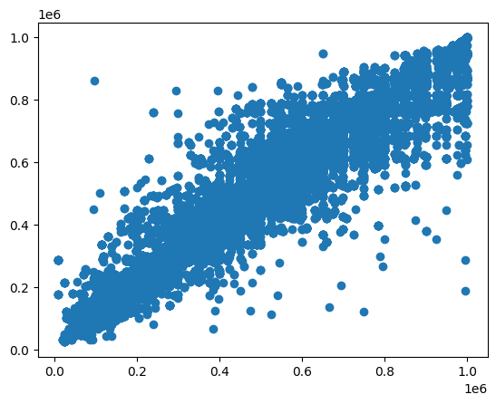
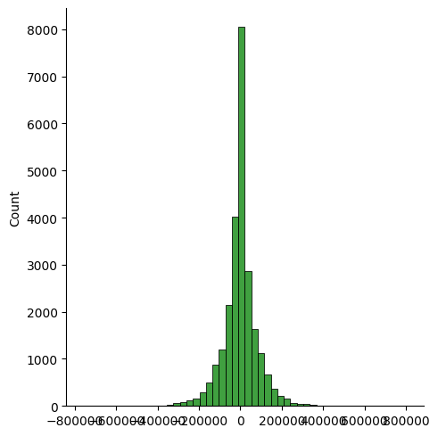
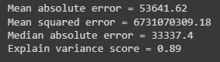
Results of Decision Tree Regression After Fixing Overfitting
Scatter Plots
Distplot

Slide 15
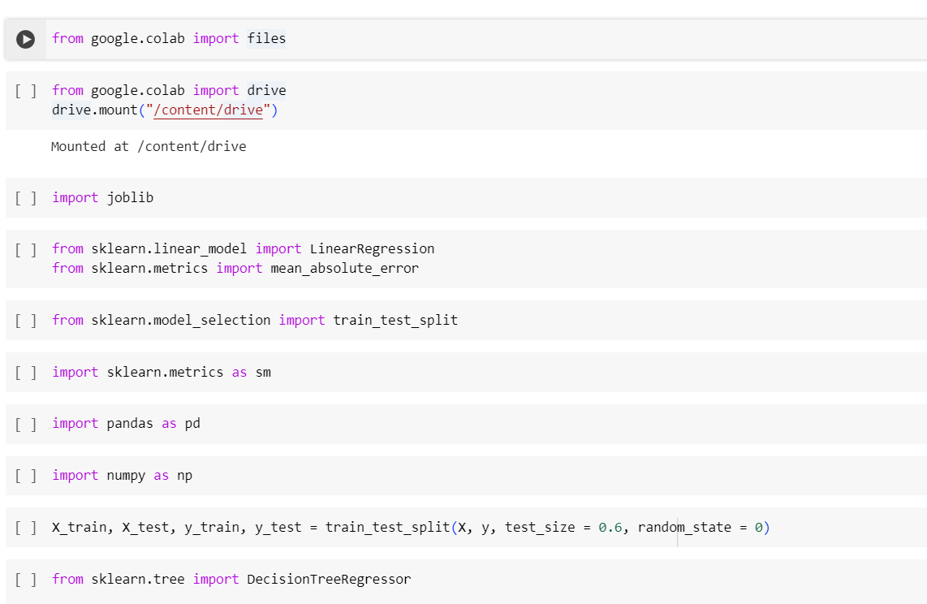
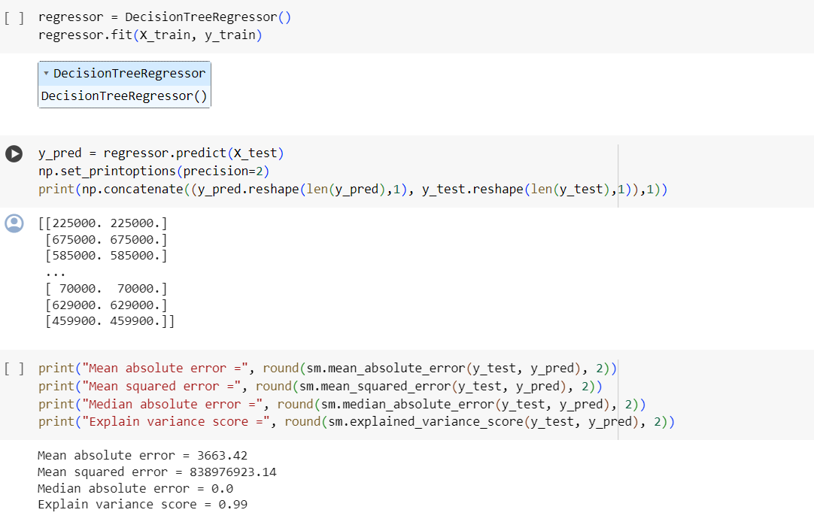
Codes

Slide 16
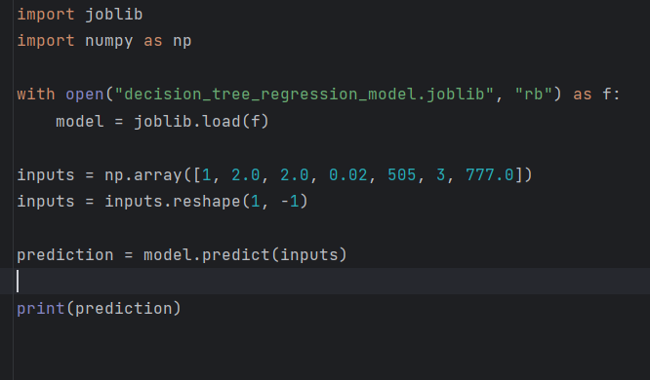

Codes

Slide 17
Libraries
Joblib
Joblib is a set of tools to provide lightweight pipelining in Python. Joblib is optimized to be fast and robust on large data in particular and has specific optimizations for numpy arrays
Pandas
Pandas is a fast, powerful, flexible and easy to use open-source data analysis and manipulation tool,
built on top of the Python programming language.
Sklearn
Scikit-learn provides a wide range of tools for working with machine learning algorithms, including regression models, classification models, clustering, dimensionality reduction, and more.
Seaborn
A statistical data visualization library based on Matplotlib that provides a high-level interface for drawing attractive and informative statistical graphics.
NumPy
A library for numerical operations in Python, providing support for large, multi-dimensional arrays and matrices.
google.colab
İt is a module specifically designed for Google Colab (Colaboratory), the cloud-based Jupyter notebook environment provided by Google. It provides functionality that is specific to the Colab environment, allowing users to interact with Google Colab features and settings.
Matplotlib
Matplotlib is a comprehensive library for creating static, animated, and interactive visualizations in Python.

Slide 18
Thank you for listening

